Slide 1
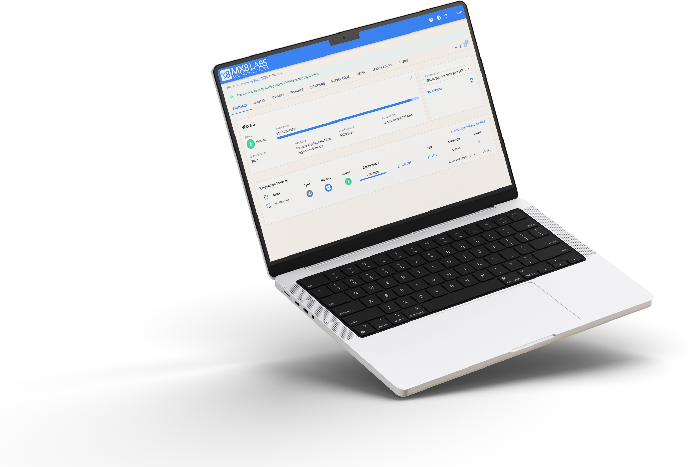
Challenger Brands.
Consumer Insights.
How U.S. Consumers
Discover and Choose
Smaller Brands.
n = 405 | U.S. General Population

Slide 2
Study Overview
Challenger Brands Consumer Survey
405
Total
Responses
Topics Covered
Brand switching behavior & frequency
Category preferences for challenger brands
Purchase motivations & hesitation factors
Brand trust & ethical perception
Discovery channels & shopping styles
MaxDiff brand preference (Retail & QSR)
US
General
Population
15
Core
Questions

Slide 3
The Challenger Brand Opportunity
86%
59%
have switched from a big brand to a smaller one and never looked back
of consumers choose smaller or start-up brands at least sometimes
77%
are likely to try a brand they've never heard of before
Base: n = 405 | U.S. General Population | "Never" respondents screened out

Slide 4
Where Consumers Choose Challengers
Categories where consumers are most likely to choose smaller, independent, or start-up brands (select all)
Food & Beverage
70%
Apparel & Accessories
50%
Beauty & Personal Care
41%
Home Goods
39%
Health & Wellness
33%
Pet Products
29%
Tech & Electronics
21%
Baby/Kids
16%

Slide 5
What Drives the Switch
Motivations for buying from smaller, independent, or start-up brands (select all)
Lower prices / better value
52%
Unique or innovative products
39%
Curiosity / try something new
38%
Supporting small businesses
36%
Better quality
36%
Recommendations
33%
Better customer service
22%
Direct relationship with brand
20%
Ethical / sustainable practices
19%

Slide 6
Trust & Perception
66%
75%
53%
believe smaller brands are more ethical or socially responsible
feel smaller brands understand people like them better
like supporting smaller brands, but don't always choose them
20% strongly agree + 46% somewhat agree
26% strongly agree + 49% somewhat agree
The #1 sentiment among respondents
Key Insight: Consumers see smaller brands as more authentic, ethical, and personally relevant

Slide 7
How Consumers Discover New Brands
Where consumers typically discover new brands or products (select all)
Retail stores
45%
Word of mouth
44%
Social media
42%
Search (Google, Amazon)
39%
Online ads
30%
Influencer recommendations
20%
Events, pop-ups, markets
19%
News articles or blogs
16%
Subscription boxes
7%

Slide 8
What Drives Trial
Factors that most increase likelihood of trying a small or unknown brand (ranked top 3)
Ranked #1
Any Top 3
Trusted reviews
20%
51%
Lower price
18%
45%
Recommended by a friend
16%
35%
Available at trusted retailer
13%
42%
Trial / sample size
13%
35%
Easy return policy
6%
25%
Social mission or values
5%
18%
Media coverage / buzz
4%
17%
Celebrity / influencer endorsement
3%
10%

Slide 9
Brand Interest: MaxDiff Results
"Most interested in trying" average score from $100 gift card MaxDiff exercise
Retail Brands (n=210)
QSR Brands (n=195)
Amazon Basics
1.61
Raising Cane's
1.44
Alo Yoga
1.36
Panera Bread
1.41
Lululemon
1.31
Popeyes
1.29
Gymshark
1.28
McDonald's
1.25
Everlane
1.25
Cava
1.24
Nike
1.24
Wendy's
1.23
Allbirds
1.21
Chipotle
1.21
Bombas
1.17
Subway
1.21
Quince
1.16
Sweetgreen
1.20
Blaze Pizza
1.17
Shake Shack
1.13
Bojangles
1.11

Slide 10
Key Takeaways
1
Challenger brands have a real opening
2
Value is the top motivator, but it's not just about price
3
Trust is the key barrier to conversion
86% of consumers choose smaller brands at least sometimes, and 59% have permanently switched from a big brand.
52% cite lower prices, but curiosity (38%), unique products (39%), and supporting small business (36%) are close behind.
Trusted reviews (20%) and lower price (18%) are the top trial drivers. Being in a trusted retailer matters most for sustained adoption (42% any top 3).
4
Smaller brands own the authenticity narrative
5
Discovery happens everywhere, but brick-and-mortar leads
66% see smaller brands as more ethical, and 75% feel they're better understood by smaller brands than large corporations.
Retail stores (45%), word of mouth (44%), and social media (42%) are the top three discovery channels.

